Slide 1
Flight Delay Prediction
Megh Raj Upreti
Mohammed Zoher Guniem
9th March 2020
DAT 500 – University of Stavanger

Slide 2
Introduction
A flight delay is said to occur when an airline lands or takes off later than its scheduled arrival or departure time respectively
Usually > 15 minutes is considered as flight delay
Every year, 23% of the flights are delayed or cancelled, costing 8 billion dollars to airlines, and 20 billion dollars to travellers in lost time and money
More delay results higher fuel expenses, operating costs, maintenance

Slide 3
Research problem
Primary Research question
Will a domestic flight from state of USA arrive at destination airport with or without delay?
Secondary research questions
Which airport is the busiest or least busy among all the airports?
Which carrier suffers most delays and least delayed carrier?
When is the best day of week/time to travel to minimize delays?

Slide 4
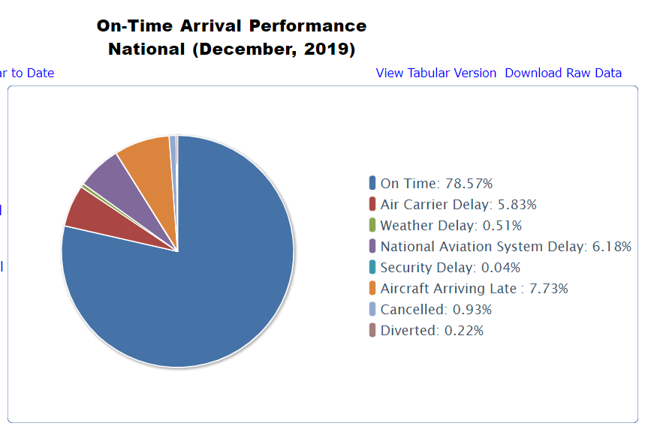
Types of Delays
https://www.transtats.bts.gov/OT_Delay/OT_DelayCause1.asp

Slide 5
Dataset
Datasets from: Bureau of Transportation Statistics (Domestic flights for USA)
1.5 GB data consisting of flights of 2019 for all months(But data is available from 1987)
Attributes: 29 variables- Year, Month, DayofMonth, DepTime, ArrTime, FlightNimber, Tail Number, ArrDelay, Depdelay and many more (Bureau of Transportation Statistics)

Slide 6
Related Works:
•”Predicting Flight Delays” in 2012 (Lawson & Castillo), used flights datasets but included several years, which resulted in an impressive number of data points (135 million of flights) with weather data only. Used SVM, random forests, and naïve Bayes. All three methods performed about equivalently, but with error rates that were not clearly much better than a trivial predictor
”Predicting airline delays” in 2012 (Bandyopadhyay & Guerrero, 2012), focused only on one airport(Chicago) and one airline company(AA)for 2007-08, with weather data only. Even though they were able to achieve a good score, their model is restricted to 80000 records and may not generalize well to other airlines and airports. Used SVM, Naïve Bayes and Logistic regression

Slide 7
Models we planned:
Decision Trees
Random Forest
XGBoost

Slide 8
References
Bandyopadhyay, R. and Guerrero, R. Predicting airline delays. Technical report, Computer Science Department, CS 229, Stanford University, Stanford, CA, 2012
https://engineering.berkeley.edu/news/2010/11/flight-delays-cost-more-than-just-time/
http://cs229.stanford.edu/proj2016/report/DuperierSauvestreLeaf-ModelingFlightDelays-report.pdf
Lawson, D. and Castillo, W. Predicting flight delays. Technical report, Computer Science Department, CS 229, Stanford University, Stanford, CA, 2012
OST_R | BTS | Transtats. (2020). Retrieved 1 March 2020, from https://www.transtats.bts.gov/Fields.asp?Table_ID=236

